Slide 1
Y3 Parent Workshop – SPaG
Miss Martin (Zebras) and Mrs Lilly (Bears)

Slide 2
Aims of the workshop
To provide you some explanation and examples of key grammatical aspects of the Y3 curriculum.
To share some websites for further information and support.

Slide 3
What is SPaG?
SPaG is made up of 3 strands:
Spelling
Punctuation
Grammar
In Year 4, the children continue working on their Y3 SPaG knowledge but also include some new elements. It is therefore important we concrete this understanding as much as possible in Y3 so it is easier for them to use within Y4.

Slide 4
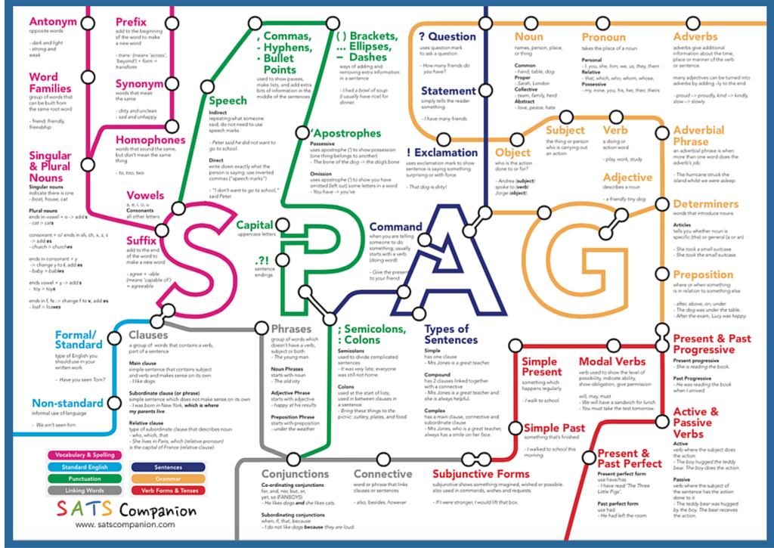
Notes:
This SPaG roadmap shows how broad the SPaG curriculum is in KS2. All of these elements will be covered by Year 6, they are not all taught in Y3 but it shows how all SPaG is linked in some way. We will briefly cover some of the key tricky SPaG concepts taught in Y3.

Slide 5
National Curriculum
The National Curriculum for English (from September 2014) placed a greater emphasis on vocabulary development, grammar, punctuation and spelling.
Expectations were raised significantly for each year group and pupils are expected to recognise and use the grammatical terminology appropriate to their year group.
Year 2 and Year 6 pupils are now tested on their SPAG knowledge as part of the national SATs tests.

Slide 6
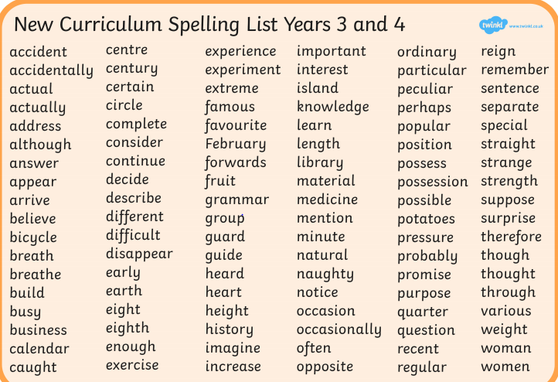
Spelling

Slide 7
Fronted adverbials
Adverbs (words that describe a verb) which are found at the start of a sentence.
They fall into 5 categories:
Time
Frequency
Place
Manner
Degree of possibility
Children are encouraged to use fronted adverbials to vary their sentence openers.
Examples –
Quietly, Michael tiptoed into the room.
As quick as a flash, mum tidied the bedroom.
Gracefully, the dancers pranced across the stage.

Slide 8
Fronted adverbials
Examples of SATs-style questions -

Slide 9
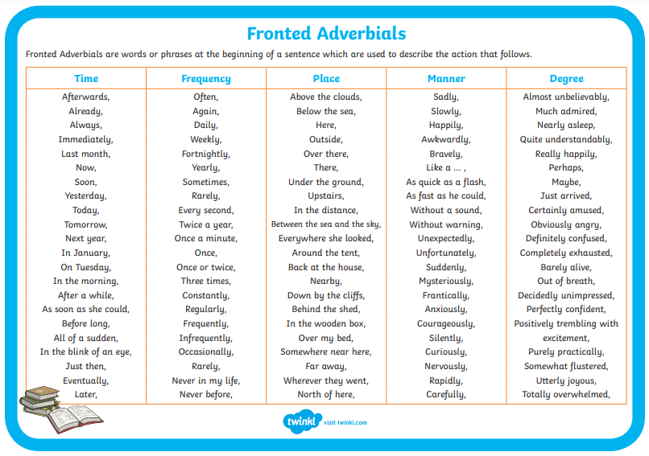
Fronted adverbials
If you would like further information about fronted adverbials, here are some video links:
https://www.youtube.com/watch?v=18sXFjb0TFc
https://www.bbc.co.uk/bitesize/topics/zwwp8mn/articles/zp937p3#:~:text=A%20fronted%20adverbial%20is%20when,the%20sentence%2C%20before%20the%20verb

Slide 10
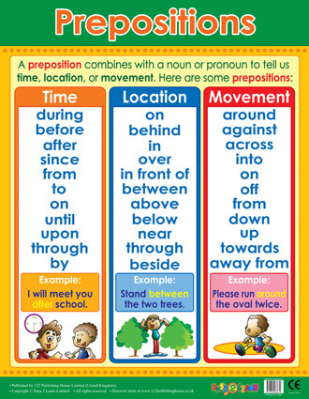
Prepositions
A preposition is a word that tells you where or when something is, in relation to something else.
Examples include:
After
Before
On
Under
Inside
Outside
The house was on the hill beside the tree – These prepositions show exactly where the house was.

Slide 11
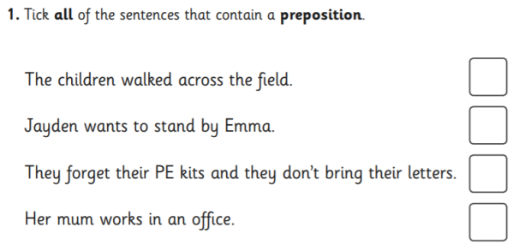
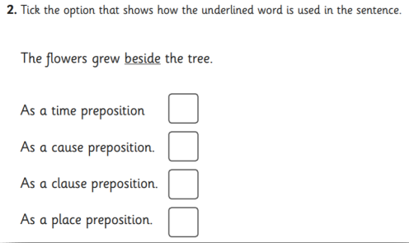
Prepositions
Examples of SATs-style questions -
If you would like further information about prepositions, here are some video links:
https://www.youtube.com/watch?v=DYd7dg2I-9k
https://www.bbc.co.uk/bitesize/topics/zwwp8mn/articles/zw38srd#ztn4qyc

Slide 12
Possessive apostrophes
In Years 3 and 4, the children focus on the use of apostrophes.
We specifically focus on apostrophes to show possession.
Singular possession – The man’s hat.
– The bike’s wheel.
Plural possession – The wolves’ prey.
– The boys’ toilets.

Slide 13
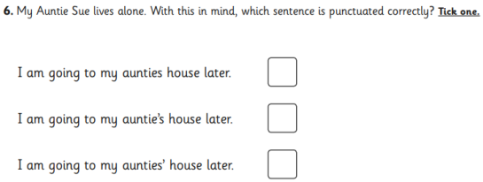
Possessive apostrophes
Examples of SATs-style questions -

Slide 14
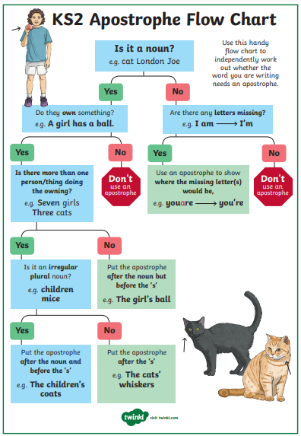
Possessive
apostrophes
If you would like further information about apostrophes, here are some video links:
https://www.bbc.co.uk/bitesize/topics/zvwwxnb/articles/zx9ydxs
https://www.youtube.com/watch?v=zNFPnVz7JB4

Slide 15
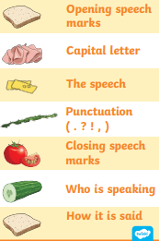
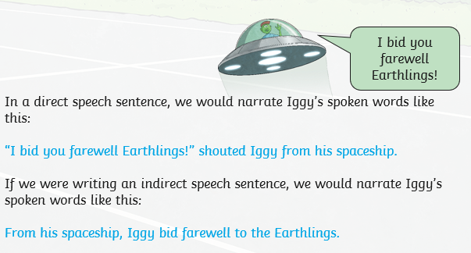
Speech
There are 2 types of speech: reported (indirect) and direct. Direct speech includes exact spoken words. Indirect is summing up what someone has said.
Children need to use and punctuate direct speech.
They need to have understanding of when to use inverted commas (speech marks).

Slide 16
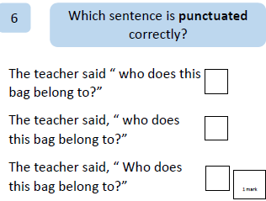
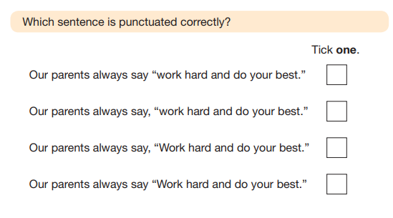
Speech
Examples of SATs-style questions -

Slide 17
Speech
If you would like further information about speech, here are some video links:
https://www.bbc.co.uk/bitesize/articles/ztcp97h#zxn4qyc
https://www.youtube.com/watch?v=uoE9ET6CtaI

Slide 18
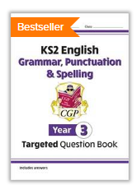
CGP books
https://www.cgpbooks.co.uk/primary-books/ks2

Slide 19
Websites to support
Primary homework help: literacy zone
https://www.primaryhomeworkhelp.co.uk/literacy/index.htm
BBC bitesize – English
https://www.bbc.co.uk/bitesize/subjects/zv48q6f
Fun English Games
https://www.funenglishgames.com/grammargames.html
Spelling Shed
https://www.spellingshed.com/en-gb/
Hamp Academy
https://www.hampacademy.co.uk/year-3-2/
Topmarks
https://www.topmarks.co.uk/english-games/7-11-years/spelling-and-grammar
Crickweb
http://www.crickweb.co.uk/ks2literacy.html

